Slide 1
Daily Household Transactions Analysis
This project analyzes and visualizes daily household transactions to help identify spending patterns and opportunities for cost-saving. It includes data cleaning, analysis, and visualization using Python.
About Dataset
The "Daily Transactions" dataset contains information on dummy transactions made by
an individual on a daily basis. The dataset includes data on the products that were
purchased, the amount spent on each product, the date and time of each transaction,
the payment mode of each transaction, and the source of each record
(Expense/Income).
This dataset can be used to analyze purchasing behavior and money management,
forecasting expenses, and optimizing savings and budgeting strategies. The dataset is
well-suited for data analysis and machine learning applications,it can be used to train
predictive models and make data-driven decisions.

Slide 2
Overview
Project Purpose
The purpose of this project is to analyze daily household transactions to gain insights into spending patterns, identify potential areas for cost-saving, and create visual representations of the data. The analysis includes cleaning the data, performing exploratory data analysis (EDA), and generating visualizations to help understand the distribution and trends in the household expenses.
Project Scope
Data Cleaning: Handling missing values, correcting data types, and standardizing data formats.
Data Analysis: Descriptive statistics, identifying spending patterns, and comparing categories.
Data Visualization: Creating charts and graphs to represent spending across different categories and time periods.

Slide 3
Steps to Complete the Project
# Import necessary libraries:-
import pandas as pd
import numpy as np
import seaborn as sns #visualisation
import matplotlib.pyplot as plt #visualisation
# Load the dataset:-
data=pd.read_csv("C:/Users/Abhijeet Kuanr/Downloads/data/Daily Household Transactions.csv")

Slide 4
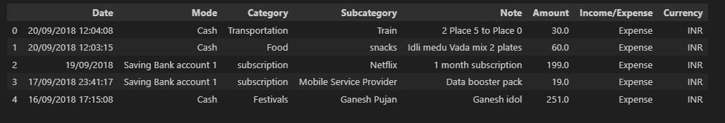
# Display the first few rows of the dataset
df.head()

Slide 5
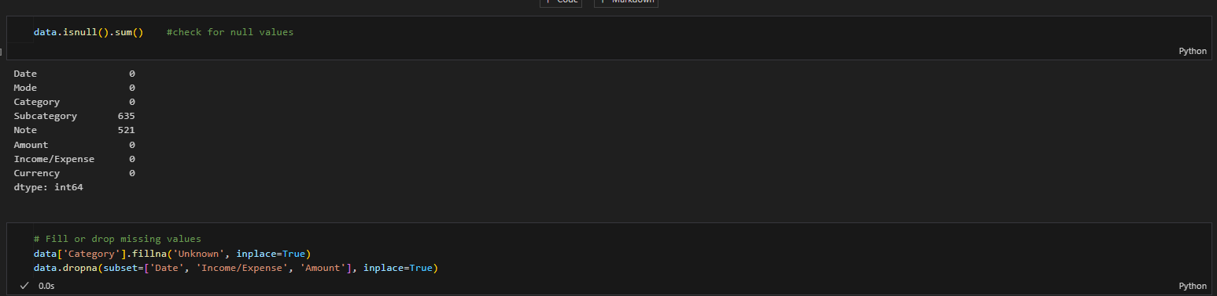
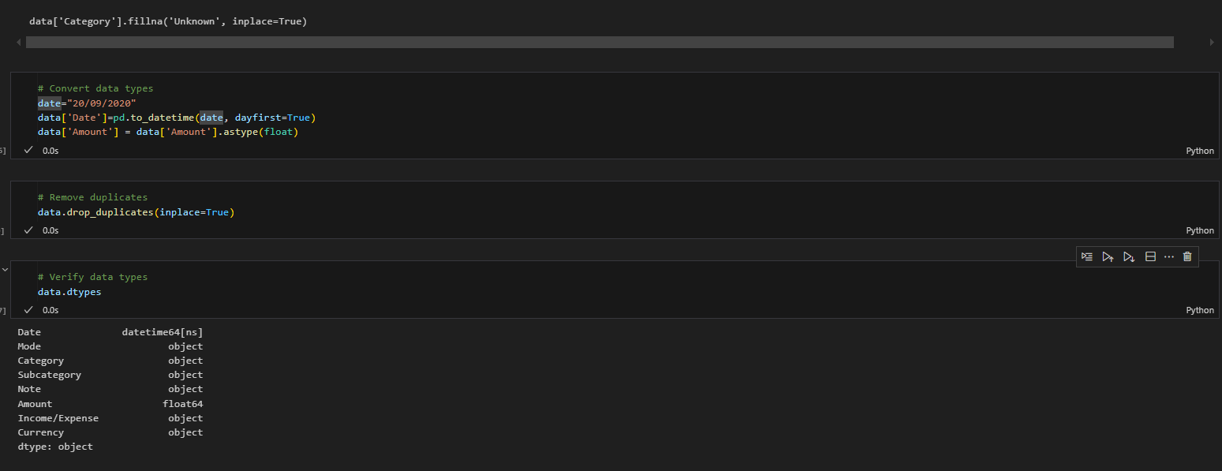
Data Processing
Before diving into analysis, we need to ensure our data is clean and ready for exploration. This includes parsing dates and checking for missing values.

Slide 6
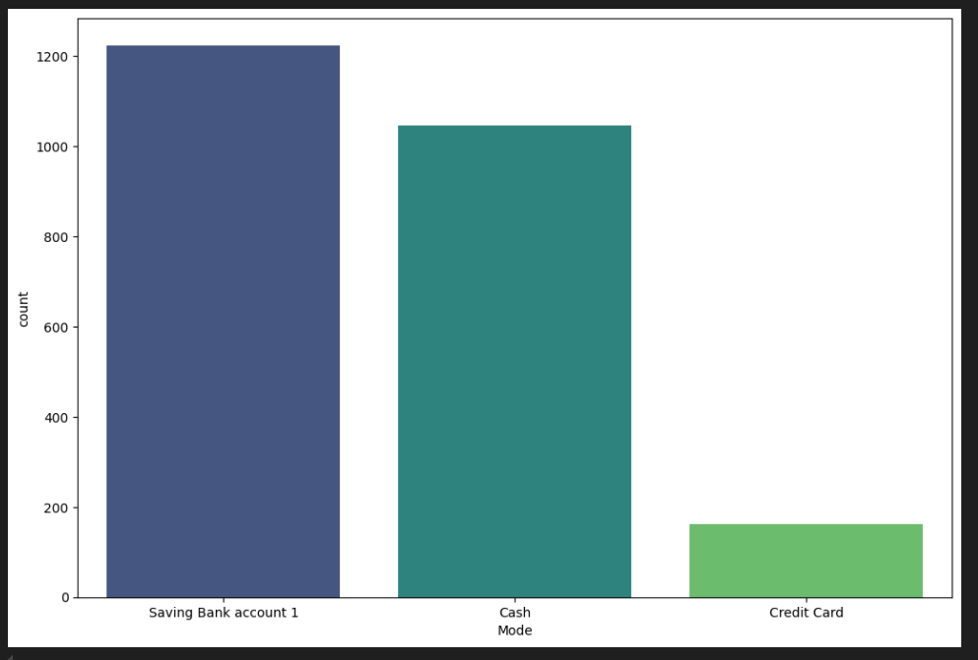
visualizations.
Mode of payment vs count
plt.figure(figsize = (12,8))
sns.countplot(data = data, x = "Mode", order =
data["Mode"].value_counts().iloc[:3].index, palette='viridis')
plt.show()
Inference:
The bar chart displaying the count of three different payment modes: "Saving Bank account 1," "Cash Mode," and "Credit Card."
"Saving Bank account 1" has the highest count, followed by "Cash Mode," while "Credit Card" has the lowest count.

Slide 7
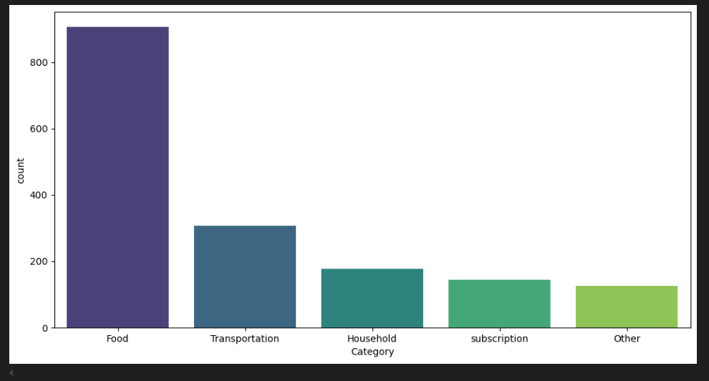
Category vs count
plt.figure(figsize=(12,6))
sns.countplot(data=data, x='Category', order= data['Category'].value_counts().iloc[:5].index, palette='viridis')
plt.show()
Inference:
The bar chart displaying the count of different spending categories: "Food," "Transportation," "Household," "Subscription," and "Other."
"Food" has the highest count, significantly higher than all other categories.
"Transportation" follows as the second highest, while "Household," "Subscription," and "Other" have relatively lower and similar counts.

Slide 8
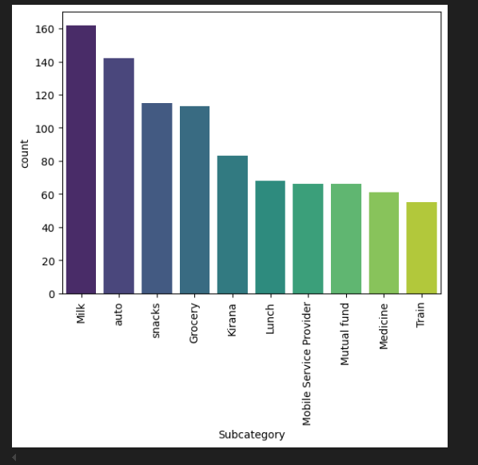
Subcategory vs count
plt.Figure(figsize=(12,6))
sns.countplot(data=data, x='Subcategory', order=data['Subcategory'].value_counts().iloc[:10].index, palette='viridis')
plt.xticks(rotation = 90)
plt.show()
Inference:
The bar chart representing the count of different subcategories of expenses.
"Milk" has the highest count, followed by "Auto," "Snacks," and "Grocery."
Other subcategories such as "Kirana," "Lunch," "Mobile Service Provider," "Mutual Fund," "Medicine," and "Train" have relatively lower counts.
The bars are color-coded and arranged in descending order of count for better visualization.
The x-axis represents different subcategories, while the y-axis represents the count.

Slide 9
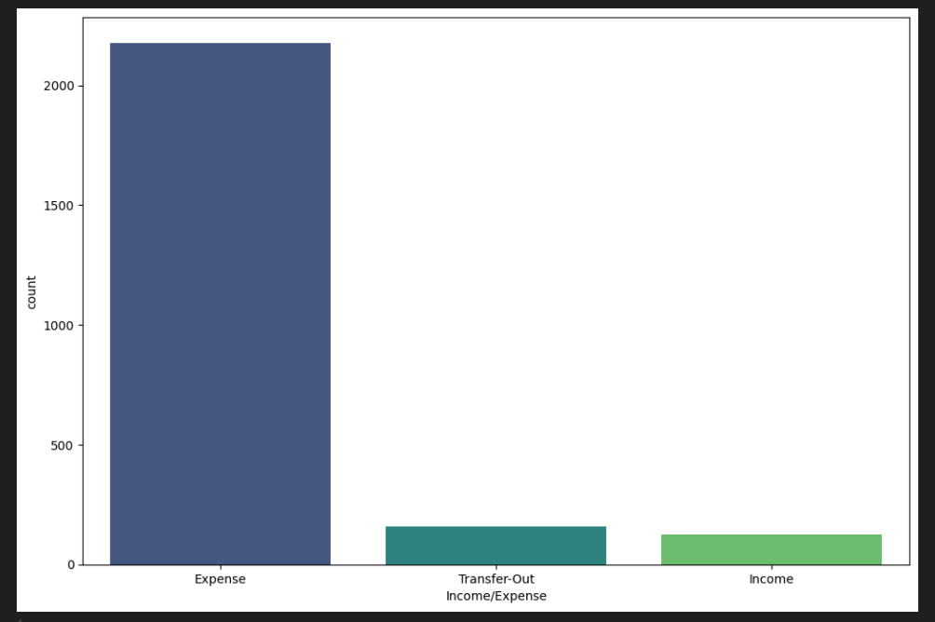
Income vs count
plt.figure(figsize=(12,8))
sns.countplot(data=data, x='Income/Expense',palette='viridis')
plt.show()
Inference:
The bar chart comparing the counts of "Expense," "Transfer-Out," and "Income" categories.
"Expense" has the highest count, significantly larger than both "Transfer-Out" and "Income," which have relatively smaller and similar counts.

Slide 10
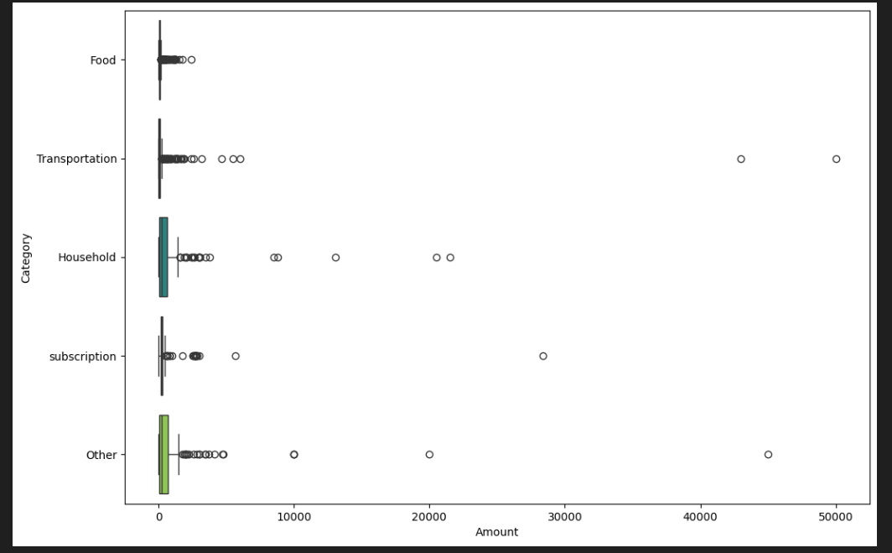
Amount vs Category
plt.figure(figsize = (12,8))
sns.boxplot(data = data, x = "Amount", y = "Category", order =
data["Category"].value_counts().iloc[:5].index, palette='viridis')
plt.show()
Inference:
The box plot showing the distribution of amounts across different spending categories, including Food, Transportation, Household, Subscription, and Other.
Each category has several outliers, with some extreme values reaching up to 50,000, indicating a wide range of spending variations.

Slide 11
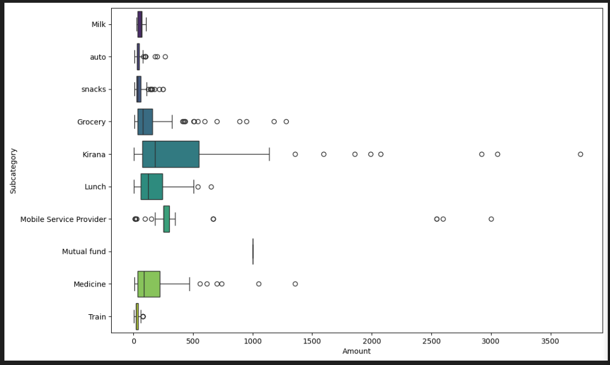
Amount vs Subcategory
plt.figure(figsize = (12,8))
sns.boxplot(data = data, x = "Amount", y = "Subcategory", order =
data["Subcategory"].value_counts().iloc[:10].index,palette='viridis' )
plt.show()
Inference:
The box plot showing the distribution of spending amounts across different subcategories such as Milk, Auto, Snacks, Grocery, Kirana, Lunch, and others.
Several subcategories have significant outliers, with some transactions exceeding 3500, indicating occasional high expenditures in certain areas.

Slide 12
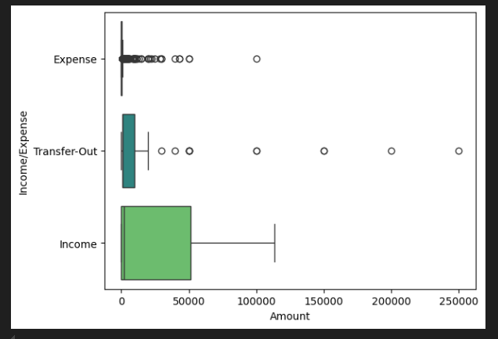
Amount vs Income
sns.boxplot(data = data, x = "Amount", y = "Income/Expense", palette='viridis');
Inference:
The box plot representing the distribution of amounts across three categories: Expense, Transfer-Out, and Income.
Income has a wider distribution with significant variability, while Expense and Transfer-Out have several outliers, indicating occasional large transactions.

Slide 13
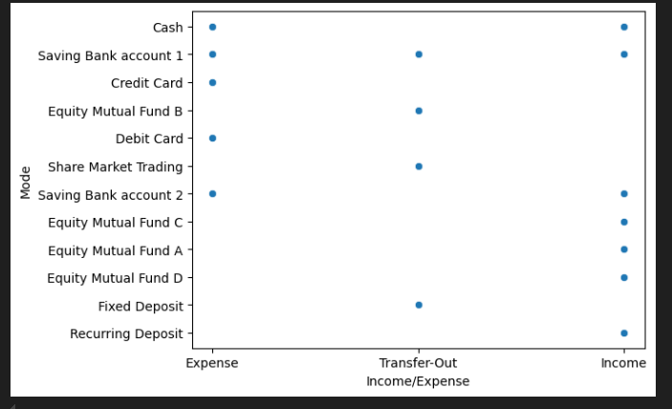
Income vs Payment mode
sns.scatterplot(data = data,x = "Income/Expense", y = "Mode",);
Inference:
The scatter plot that categorizes different transaction modes (e.g., Cash, Credit Card, Fixed Deposit) against Income, Expense, and Transfer-Out.
Each dot represents a transaction mode associated with one of these financial categories, showing which modes are used for different types of transactions.

Slide 14
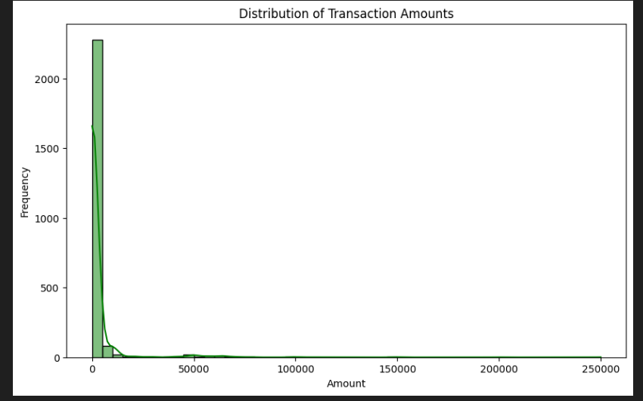
Distribution of Transaction Amounts
# Distribution of transaction amounts
plt.figure(figsize=(10, 6))
sns.histplot(data['Amount'], bins=50, kde=True, color='g')
plt.title('Distribution of Transaction Amounts')
plt.xlabel('Amount')
plt.ylabel('Frequency')
plt.show()
Inference:
The histogram with a KDE (Kernel Density Estimate) overlay, representing the distribution of transaction amounts.
Most transactions have low amounts, as indicated by the high frequency of small values.
There are a few high-value transactions, but they are rare, as seen in the long tail on the right.
The distribution is highly right-skewed, indicating a concentration of smaller transaction amounts.

Slide 15
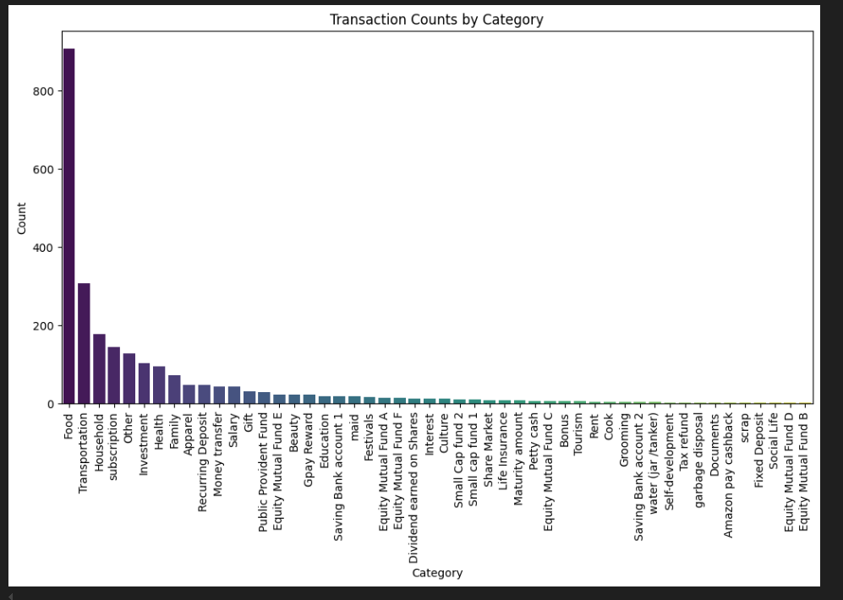
Transaction Counts by Category
# Transaction counts by category
plt.figure(figsize=(12, 6))
sns.countplot(data=data, x='Category', order=data['Category'].value_counts().index, palette='viridis')
plt.title('Transaction Counts by Category')
plt.xlabel('Category')
plt.ylabel('Count')
plt.xticks(rotation=90)
plt.show()
Inference:
The bar chart displays transaction counts categorized by different expense and income categories.
"Food" has the highest transaction count, followed by "Transportation" and "Household."
The majority of transactions are concentrated in a few categories, while others have significantly lower counts.
The distribution is highly skewed, with a long tail of categories having relatively few transactions.

Slide 16
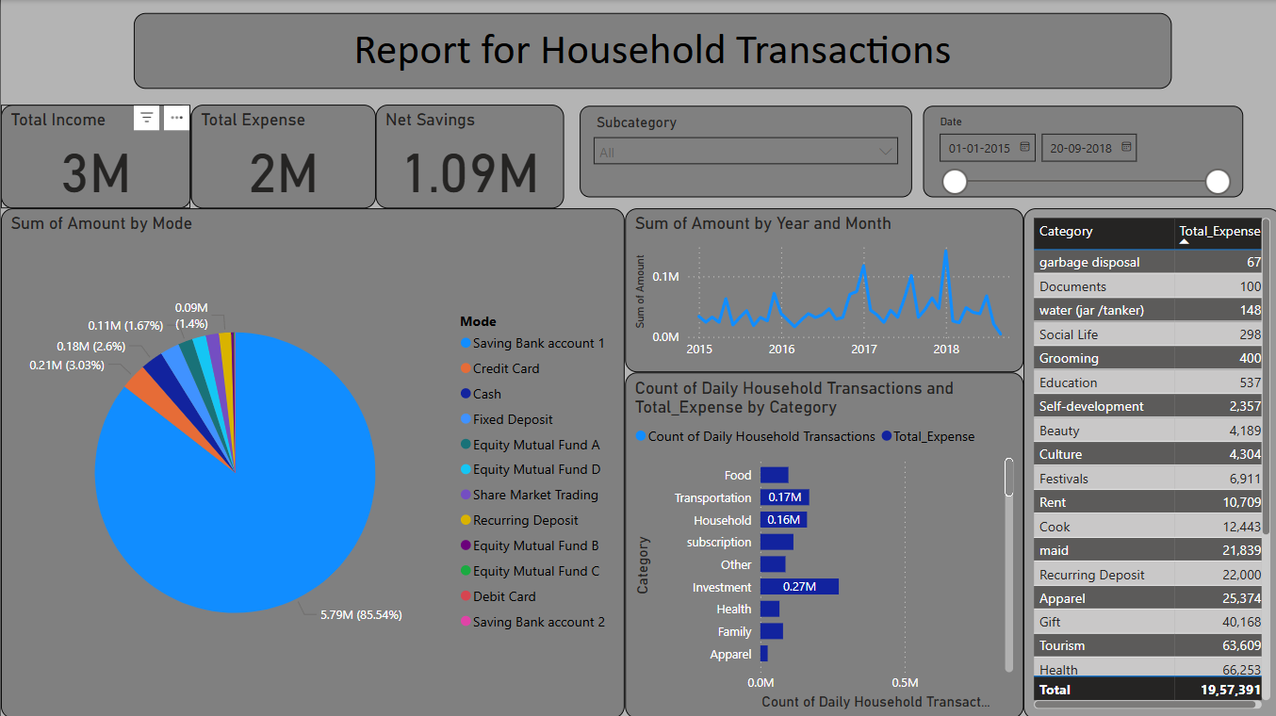
Power Bi Dashboard

Slide 17
Conclusion:
The financial transactions dataset was analyzed to identify key trends and insights. The
data cleaning process involved handling missing values, correcting data types, and
removing duplicates. Exploratory Data Analysis (EDA) revealed the distribution of
transaction amounts, transaction counts by category and type, and significant patterns
over time. Time series analysis highlighted monthly and daily transaction trends.
Correlation analysis identified relationships between different transaction categories.
Key Findings
● The distribution of transaction amounts showed a right-skewed pattern with most
transactions clustered around lower values.
● Sales and Purchases were the most common transaction categories.
● Credit transactions were more frequent than Debit transactions.
● Monthly transaction trends revealed seasonal patterns with peaks in certain
months.
This project provides valuable insights into daily financial transactions, helping to
inform decision-making and strategic planning.

